Slide 1

1.Home Page:-

Slide 2

2.About Page:-

Slide 3

3.Read Online Page:-

Slide 4
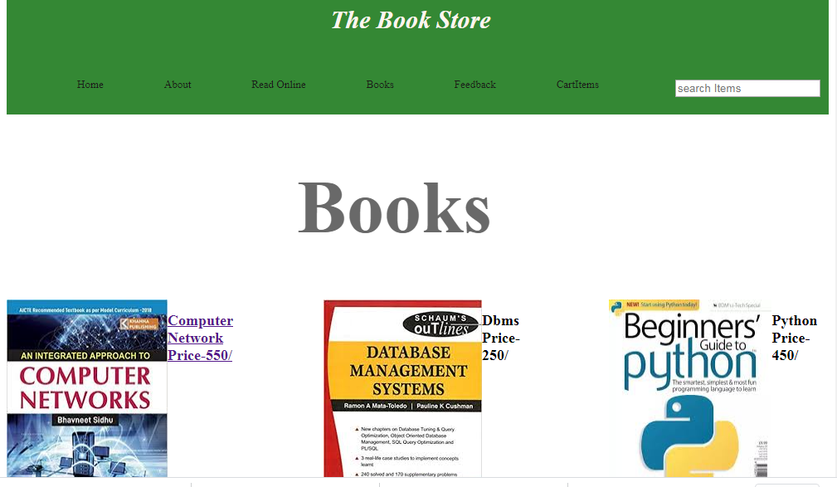
4.Books:-

Slide 5
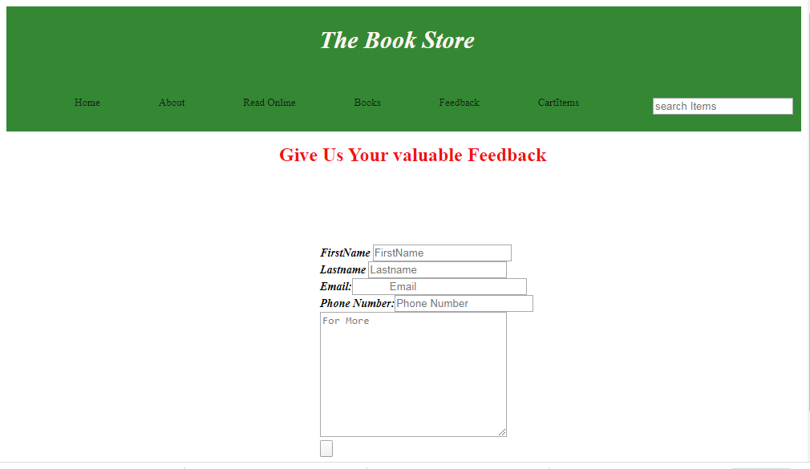
5.Feedback:-

Slide 6

6.Cart Books:-

Slide 7
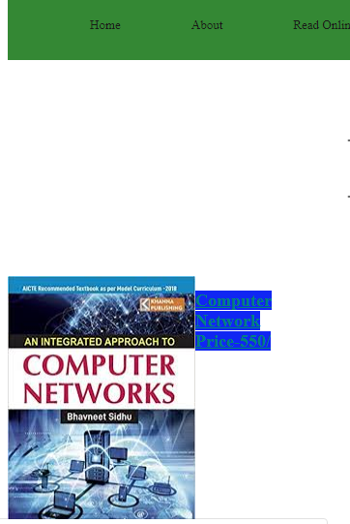
7.Purchase a book:-

Slide 8

8.Selected Book Ready for Purchase in cart item:-

Slide 9
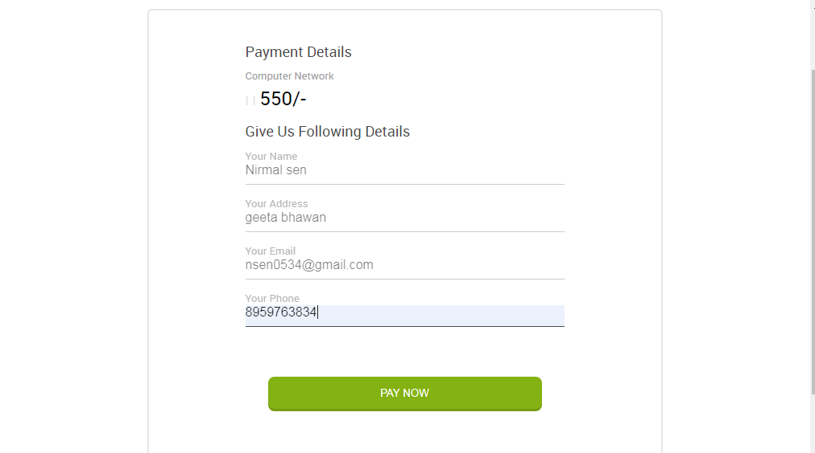
9.Customer Detail:-

Slide 10
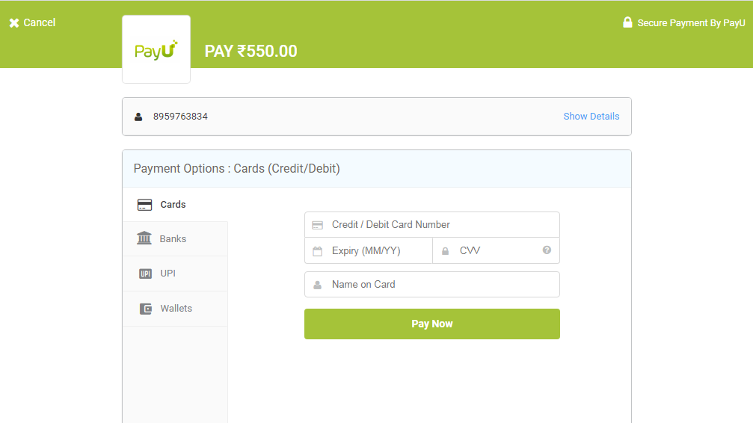
10.PayU Payment Gateway:-

Slide 11
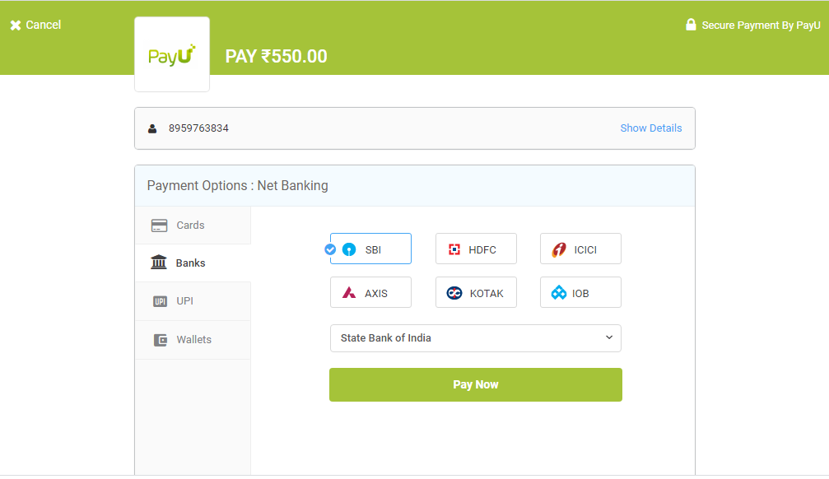
11.Payment Modes:-

Slide 12
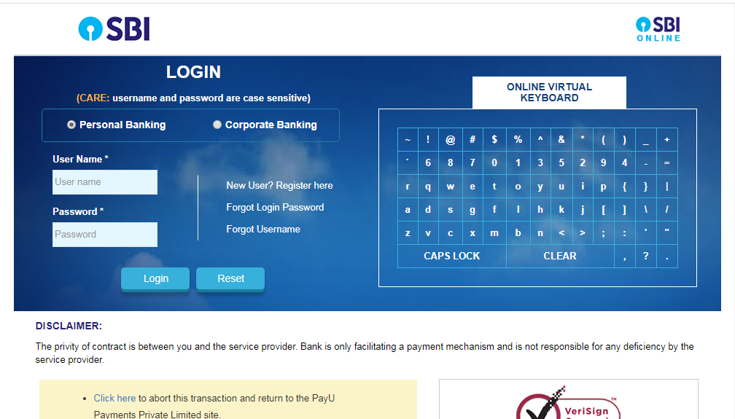
12.Payment Through SBI Net banking:-

Slide 13
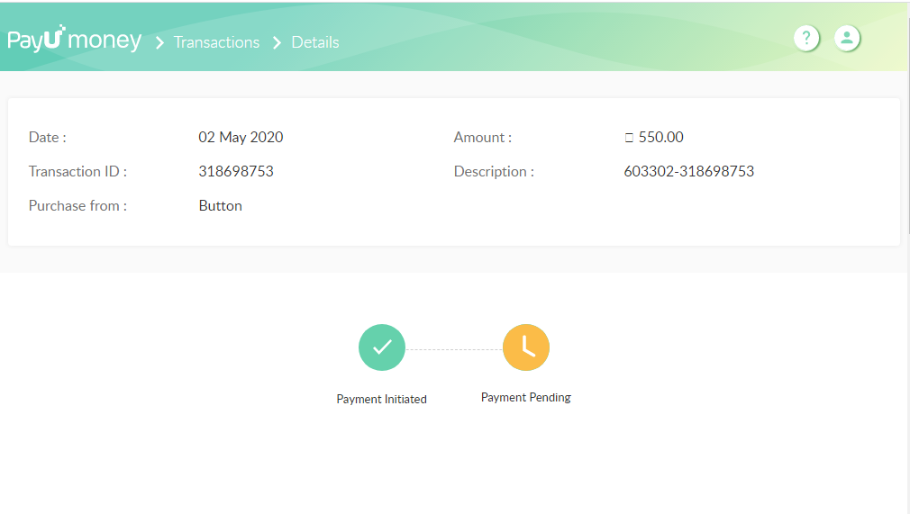
13.Admin Side Dashboard For Transactions Details:-

